Slide 1

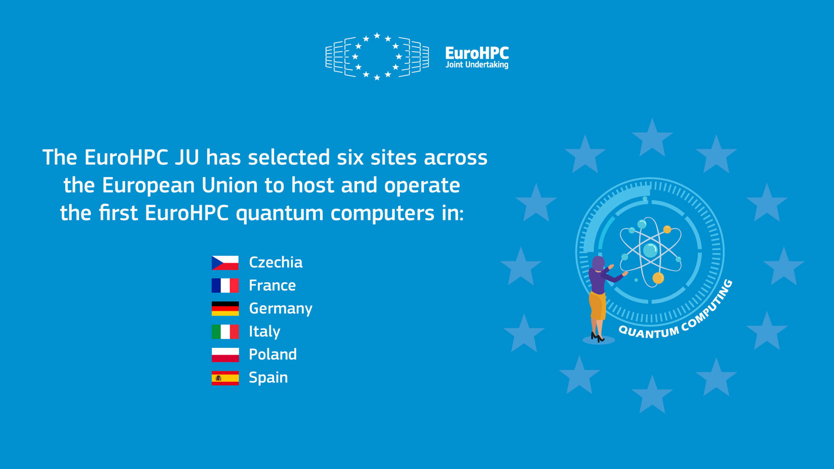
Disclaimer
Dear Participant,
Please be aware that this session is being recorded and
will be uploaded to third party services afterwards. If You do not consent, please disconnect from the call now
28 November 2025

Slide 2
WELCOME TO THE
Info Session on EuroHPC Quantum Grand Challenge (QGC)
28 November 2025

Slide 3
Agenda
10:00 – 10:10 : Welcome and Introduction + Policy and Quantum Strategy (DG CNECT)
10:10 – 10:20 : Phase 1: Administration and Scope (EuroHPC JU)
10:20 – 10:45 : Phase 2: EIB Venture Debt + EIB InvestEU Advisory elements (EIB)
10:45 – 11:30 : Live Q&A
28 November 2025

Slide 4
Agenda
10:00 – 10:10 : Welcome and Introduction + Policy and Quantum Strategy (DG CNECT)
28 November 2025

Slide 5



Info Session
Quantum Grand Challenge
Christian TREFZGER, CNECT C2 Quantum Technologies
Briefing

Slide 6
Quantum Technologies:
Why They Matter?
Quantum technologies use quantum physics to build :
🖥️
🔒
📡
Ultra-powerful
Computing
Ultra-secure
Communication
Ultra-precise
Sensing & Measurement
They transform medicine, energy, security, and many other sectors
critical technologies

Slide 7
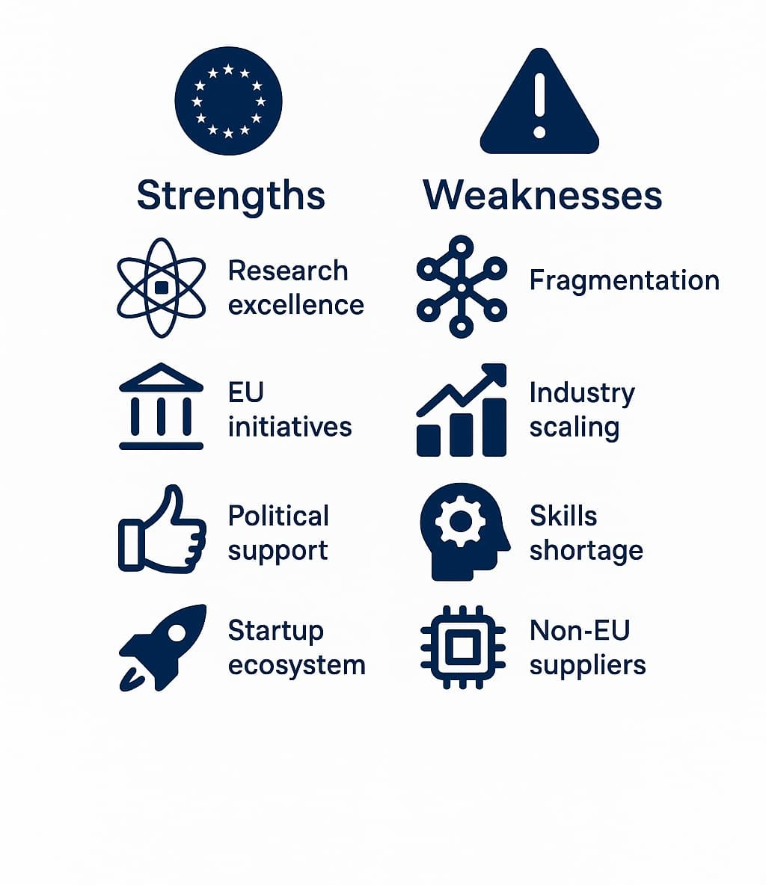
Europe Strengths and weaknesses
💪 Strengths
Research excellence: universities, labs, RTOs
Pan-EU initiatives: Quantum Flagship, EuroHPC-QCS, EuroQCI
Political support: Quantum Declaration, EU strategy
Growing startup ecosystem and innovation potential
⚠️ Weaknesses
Fragmentation across Member States
Difficulty scaling from research to industry
Shortage of skilled quantum professionals
Dependence on non-EU suppliers for key components

Slide 8
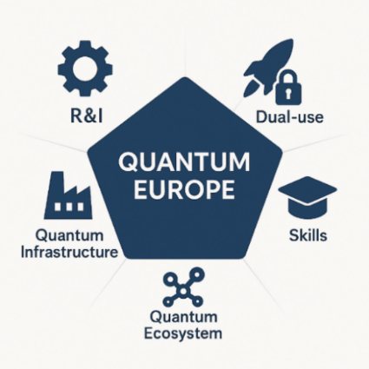
Europe’s Quantum Vision
🎯 Europe to become the world’s quantum industrial powerhouse,
and market leader
Consolidate excellence, lead industrial transformation
Integrate QT in Europe’s space, security, and defense strategies
Support production, design, and application development
Develop a world-class workforce, education, training, talent mobility
Invest in startups/scaleups, secure supply chains, and industrialize

Slide 9

Quantum Grand Challenge
The problem: Findings of EIB quantum market study
Worldwide distribution of quantum global funding
Worldwide distribution of quantum companies
EU 5%
EU 25%
US 25%
⚠️
Quantum projects are not bankable, and European investors are traditionally conservative taking less risks than US (Draghi report)
Notes:
To accelerate Europe's leadership in quantum computing, the EU has launched a bold two-phase Quantum Grand Challenge to support breakthrough startups.
In Phase 1, up to 15 European startups will receive €400,000 grants each to develop and demonstrate early prototypes of their integrated quantum computing platforms—both hardware and software.
They must also deliver robust technical and financial roadmaps and prove their potential through benchmarking and real-world relevance.
After evaluation, the top 6 or 7 companies will be selected for Phase 2, where they can receive long-term investment of up to €30 million under InvestEU.
These scale-up projects will focus on bankable deployment, integration with supercomputing centres, and concrete industrial or societal use cases.
The initiative is backed by the European Investment Bank and contributes to the Strategic Technologies for Europe Platform (STEP), offering recipients the Sovereignty Seal—a quality label enabling access to broader EU and national co-financing.
This challenge is not just about funding—it’s about identifying the champions who will build Europe’s full-stack quantum computers and bring them to market.

Slide 10
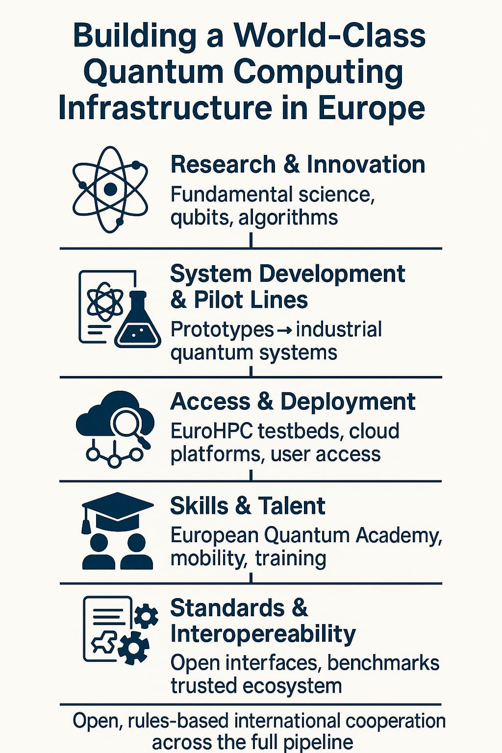
Why bankability matters?
Attract private capital and reduce dependency on subsidies → bankable companies can secure financing to scale
Accelerate commercialization and global competitiveness → investors back firms with clear business models, enabling the EU to compete with U.S. and Asia
Strengthen strategic autonomy and technology sovereignty → financially sustainable companies keep key quantum capabilities and IP within Europe

Slide 11
Quantum Grand Challenge
HORIZON-JU-EUROHPC-2026-QGC-02-01
Phase 1 – Grant
(4 months, 400k€)
12 companies
Prepare a technical and financial roadmap
Support from EIB InvestEU Advisory
Phase 2 – Convertible Loan
(5-8 years, up to 30M€)
6 companies
Bankable Deployment, Scalability, and Real-World Demonstrations
🎯 Main Goal: Support European quantum start-ups / scale-ups in developing marketable quantum computing solutions
💡Demonstrate feasibility of integrated hardware and software quantum computing systems

Slide 12
Overview
Welcome and introduction (European Commission)
Grand Challenge Phase 1 (EuroHPC Joint Undertaking)
Grand Challenge Phase 2 (European Investment Bank)
Q&A

Slide 13
Overview
Welcome and introduction (European Commission)
Grand Challenge Phase 1 (EuroHPC Joint Undertaking)
Grand Challenge Phase 2 (European Investment Bank)
Q&A

Slide 14
Overview
Welcome and introduction (European Commission)
Grand Challenge Phase 1 (EuroHPC Joint Undertaking)
Grand Challenge Phase 2 (European Investment Bank)
Q&A

Slide 15
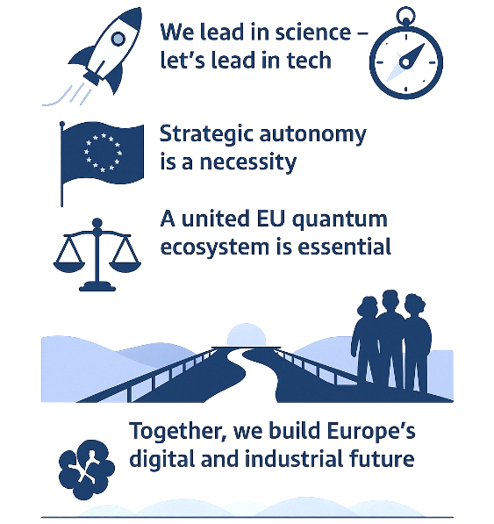
Now Is Europe’s Quantum Moment

Slide 16
Agenda
10:10 – 10:20 : Phase 1: Administration and Scope (EuroHPC JU)
28 November 2025

Slide 17
HORIZON-JU-EUROHPC-2026-QGC-02
Quantum Grand Challenge
  The action support the EU’s ambition to strengthen its position as a global leader in quantum computing technologies. The action is tailored towards European quantum computing startups to develop their quantum computing solutions with a clear market perspective
  The action is implemented in two phases and within the 1st phase, European start-ups are invited to prepare a technical- and financial roadmap demonstrating their potential together with physical proofs and/ or preliminary prototypes. By end of Phase 1 each company must demonstrate a convincing quantum computing concept, including a clear financial roadmap
GB decision
(approval of the Annual Work Plan and launch of call)
Publication of the call on F&T portal and opening for submissions
Info Session (DG CNECT, EIB and EuroHPC JU)
Foreseen
Closing of call
Evaluation
Approval of the ranked lists of proposals by GB
(written procedure)
Grant Agreement preparation
Start of Phase 1
with around 12 European start-ups (3 months duration)
Start of Phase 2
with around 6 European start-ups - two tranche approach, implemented at the EIB
14/10/2025
Feb. / Mar. 2026
April 2026
09/10/2025
Feb. 2026
Jan. 2026
08/01/2026
28/11/2025
July 2026

Slide 18
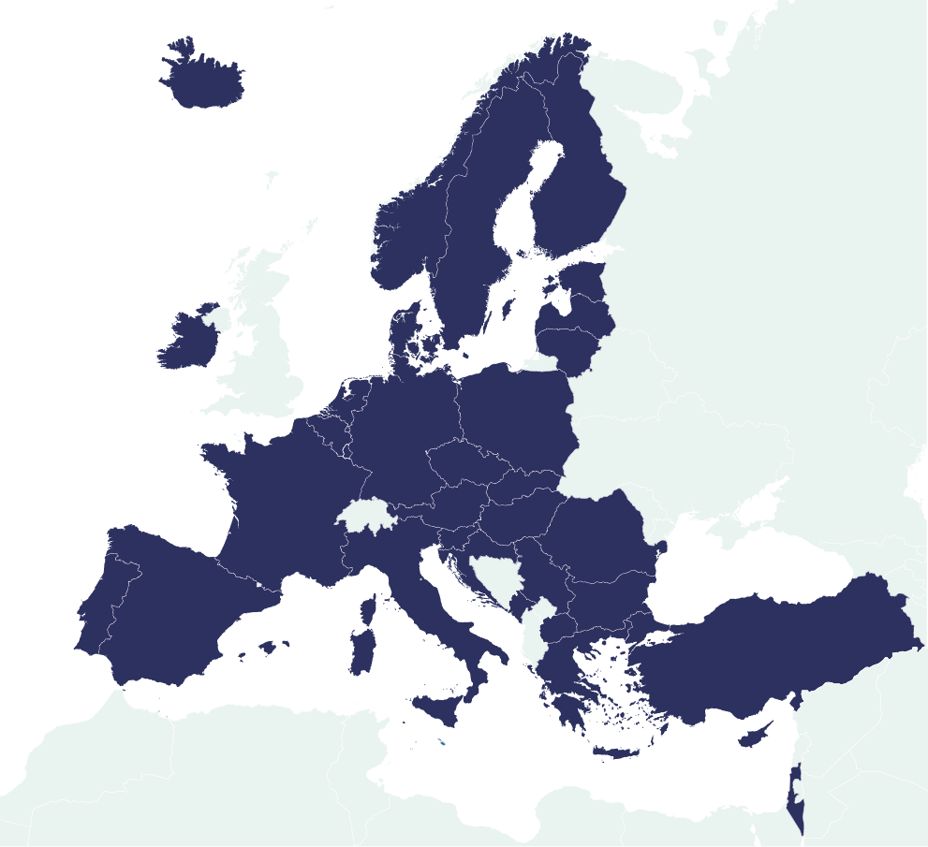
HORIZON-JU-EUROHPC-2026-QGC-02
Quantum Grand Challenge
Phase 1 – General Conditions
Call modalities: EU Funding & Tenders Portal
Type of Action: Coordination and Support Action (CSA) with 100% EU funding
Expected EU contribution per project: 200.000 – 300.000 EUR
Attention!! Modifications to general award criteria apply
Submission: Proposals for Phase 1 must be submitted via the EU Funding & Tenders Portal
Exceptional page limits: Proposals should have an indicative length of 10 pages (‘narrative text’)
Stakeholders are strongly encouraged to familiarise themselves with the Horizon Europe Programme Guide together with the Horizon Europe General Annexes for detailed instructions, information and clarification
Notes:
Develop, deploy, extend & maintain a world-leading supercomputing, quantum computing, service & data infrastructure ecosystem in Europe
Support the development of innovative supercomputing components, technologies, knowledge & applications to underpin a competitive European supply chain
Widen the use of HPC & quantum infrastructure to a large number of public & private users wherever they are located in Europe and support the development of Key skills for European science and industry

Slide 19
HORIZON-JU-EUROHPC-2026-QGC-02
Quantum Grand Challenge
Phase 1 – Expected Outcomes
Detailed technical- and financial roadmap (incl. performance milestones, risk assessment, financial viability assessment and commercialisation timelines)
Benchmarking strategy (component level, system level, application level) together with tangible proofs of principle or prototypes of a full-stack quantum computing platform (standalone software-only or hardware-only approaches will not be considered, be aware dedicated R&I activities are out of scope)
Application strategy identifying target sectors (incl. identifying industry-relevant use-cases)
Expression of interest from potential end-user partners who collaborate with the project during Phase 2
Notes:
Develop, deploy, extend & maintain a world-leading supercomputing, quantum computing, service & data infrastructure ecosystem in Europe
Support the development of innovative supercomputing components, technologies, knowledge & applications to underpin a competitive European supply chain
Widen the use of HPC & quantum infrastructure to a large number of public & private users wherever they are located in Europe and support the development of Key skills for European science and industry

Slide 20

HORIZON-JU-EUROHPC-2026-QGC-02
Quantum Grand Challenge
Phase 1 – Templates and Process
Phase 1 is implemented as a single-stage CSA and hence he appropriate template to be used can be found under Standard Application Form (HE CSA)
Please complete and provide the ownership control declaration Ownership control declaration
Please complete and provide the ethics self-assessment how-to-complete-your-ethics-self-assessment_en.pdf
Please take notice of classification-of-information-in-he-projects_he_en.pdf and if applicable complete and provide the self-assessment Tpl_Information on security issues (Part B security section) (HE)
Please note that subcontracting is not foreseen during Phase 1 (activity is implemented as a coordination and support action (CSA) focussing on technical and financial roadmaps)
An updated Q&A document summarising the received questions will be made available on F&T and can already be found under https://www.eurohpc-ju.europa.eu/media-events/events/info-session-quantum-grand-challenge-call-2025-11-28_en
Contact: ri@eurohpc-ju.europa.eu
Notes:
Develop, deploy, extend & maintain a world-leading supercomputing, quantum computing, service & data infrastructure ecosystem in Europe
Support the development of innovative supercomputing components, technologies, knowledge & applications to underpin a competitive European supply chain
Widen the use of HPC & quantum infrastructure to a large number of public & private users wherever they are located in Europe and support the development of Key skills for European science and industry

Slide 21
Agenda
10:20 – 10:45 : Phase 2: EIB Venture Debt + EIB InvestEU Advisory elements (EIB)
28 November 2025

Slide 22
Agenda
10:45 – 11:30 : Live Q&A
28 November 2025

Slide 23



Thank You!
Keep up to date with all EuroHPC JU news!
https://eurohpc-ju.europa.eu
@EuroHPC_JU
EuroHPC Joint Undertaking

