Slide 1

THE EUROPEAN HIGH PERFORMANCE COMPUTING ​
JOINT UNDERTAKING
AI Factories : Open for Business
BlackMamba Project - Lingua Custodia
Webinar
20 May 2025

Slide 2





Lingua Custodia
SAMPLE CLIENTS
Lingua Custodia is a company founded in 2011 based in Paris and Luxembourg. It masters the entire value chain of generative AI to offer secure, specialised, sovereign and frugal artificial intelligence solutions which deliver a true ROI for its regulated customers.
Lingua Custodia provides three core values:
Specialized : We believe in specialized models that outperform big ones on specific tasks
Sovereign : We use exclusively european cloud providers and possess all technical verticals
Frugal : We focus on efficiency in all aspects: capital, inference and training

Slide 3
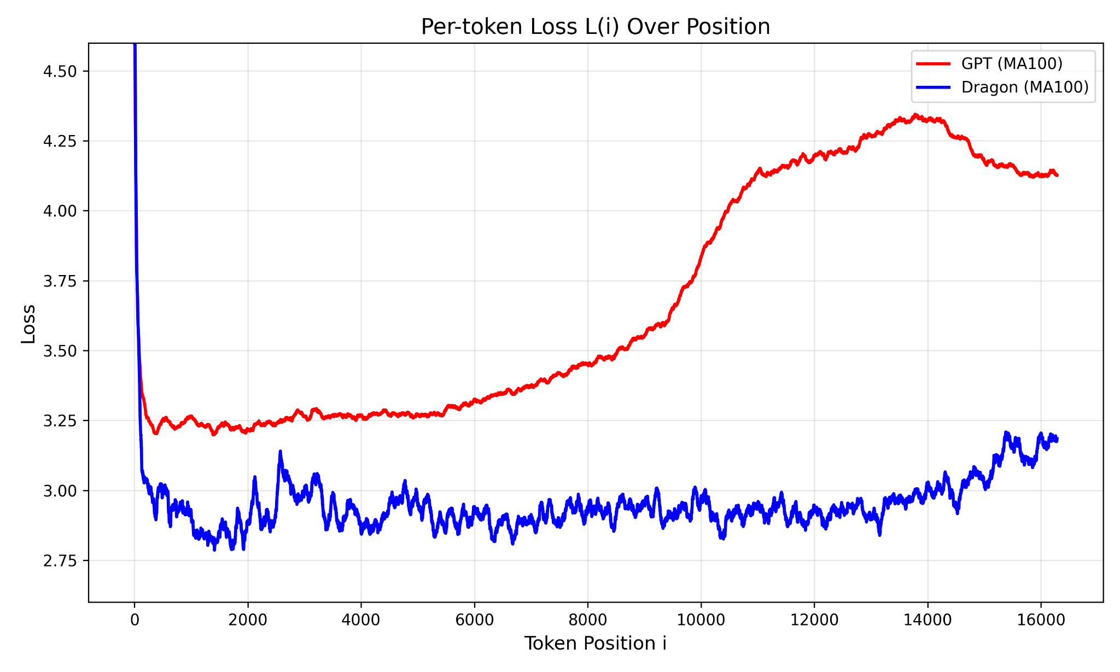
Black Mamba Project - Dragon LLM
Foundation Models
Hybrid architecture (2.5 faster inference, 75% KV Cache Reduction) leveraging state of the art Mamba architecture (GDN)
Performant architecture on long-context beyond training sequence length
Training on 9T tokens composed of 35 Languages mostly europeans
State of the art training techniques, 80% reduction in Flops to reach equivalent Llama architecture
3 sizes : 3B, 7B, 34B - open-source
Compute budget: 2 Millions hours on Leonardo HPC (Italy)
Not exhaustive list of improvements :
  Hymba
  Diff-Attention
  Scaling Layer Norm
  Rope to Nope
  Sky Ladder
  Gated Delta Network
Deep seek init
Improved Signal normalization
CCE - Cut your Vocabulary Loss
Scalable Softmax
Step Fun

Slide 4
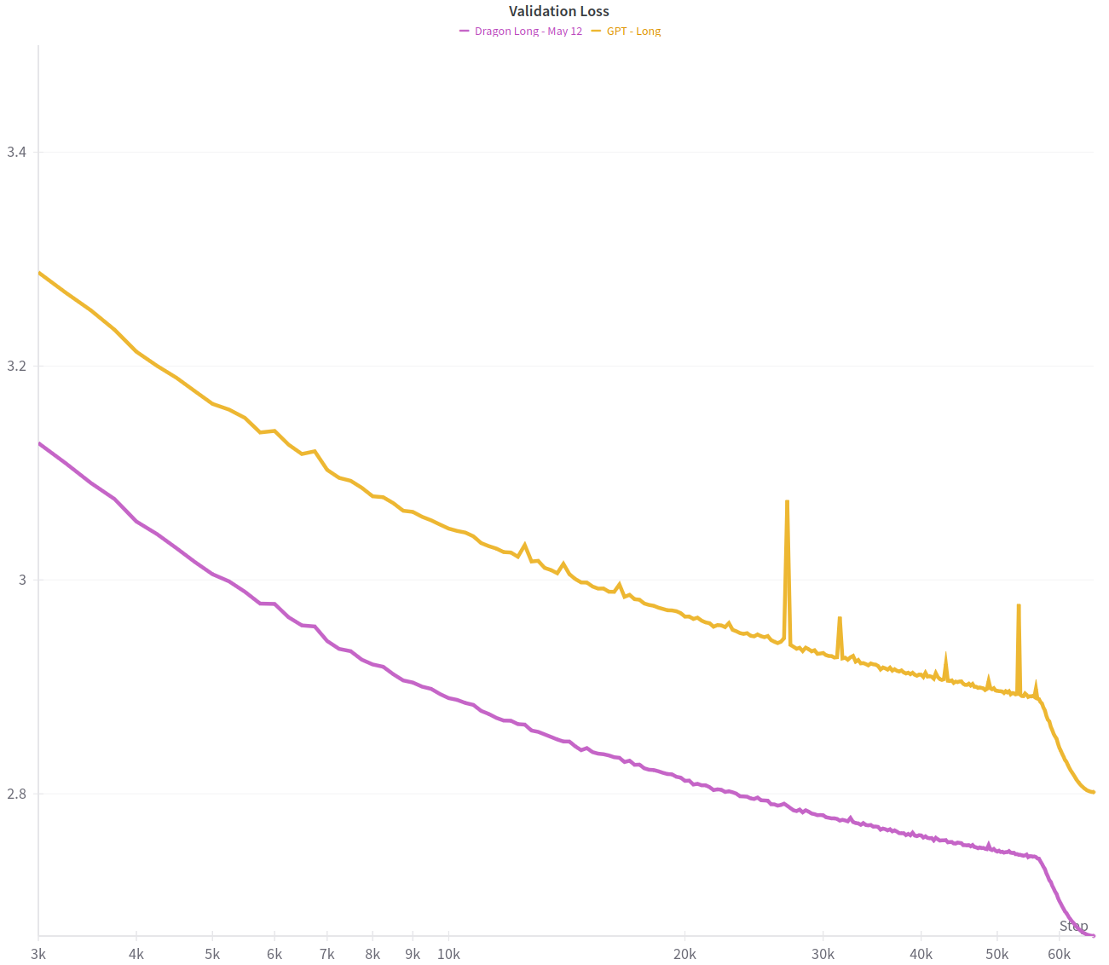
Black Mamba Project - Dragon LLM
Trying to create the Deepseek moment for Europe
 | Language Modeling (Hellaswag) | Recall (Avg SWDE+FDA)
GPT | 39,70% | 19,90 %
Dragon | 45.14% | 65,83 %
Models of 770m parameters and trained on 10B tokens - nanoGPT
0.2x Flops
Current 3B models in training
Models of 770m parameters and trained on 50B tokens - nanoGPT

Slide 5
Leonardo Cineca italy
Large scale cluster :
  3456 booster nodes - 4 A100 64GB - VRAM : 256GB per nodes
Data Parallelism - Good until 1.5B models
Low VRAM constraints means more engineering for tensor parallelism (until 3B) and interleaved pipeline parallelism (>3B)
Ultrascale Notebook by hugging face
Megatron-LM most efficient code : runs at 190 TFLOPs/s/GPU

Slide 6
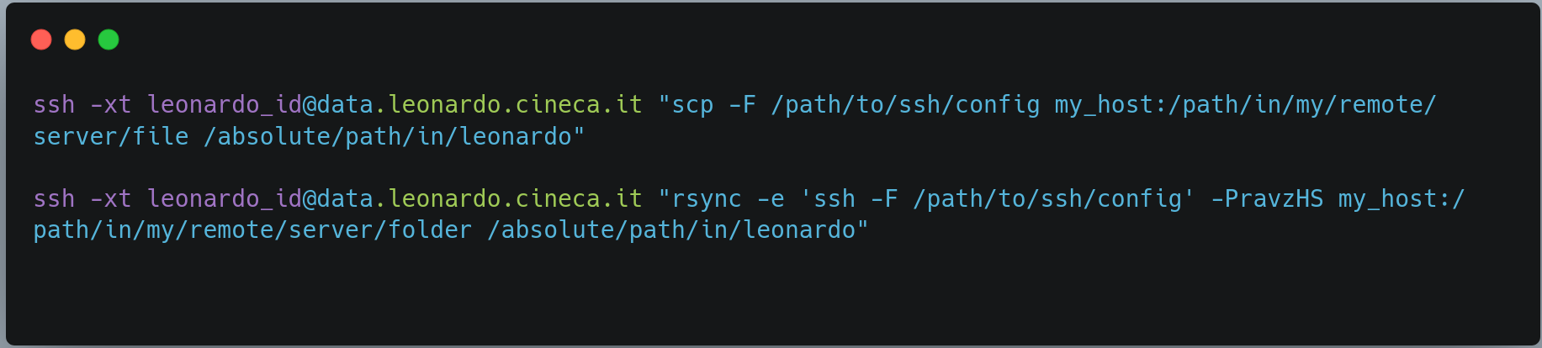
Data Transfer
Good speed good stability
Process :
Whitelist data mover nodes ip
Add a ssh config inside your home configuration
Run your data transfer command

Slide 7
Other tips and remarks
GPUs are still unstable hardware, expect crashes, prepare for them
Network issue
Ask for close nodes improves performance and reliability
Always ask for CPU time (1 millions hours) to prepare your data

Slide 8
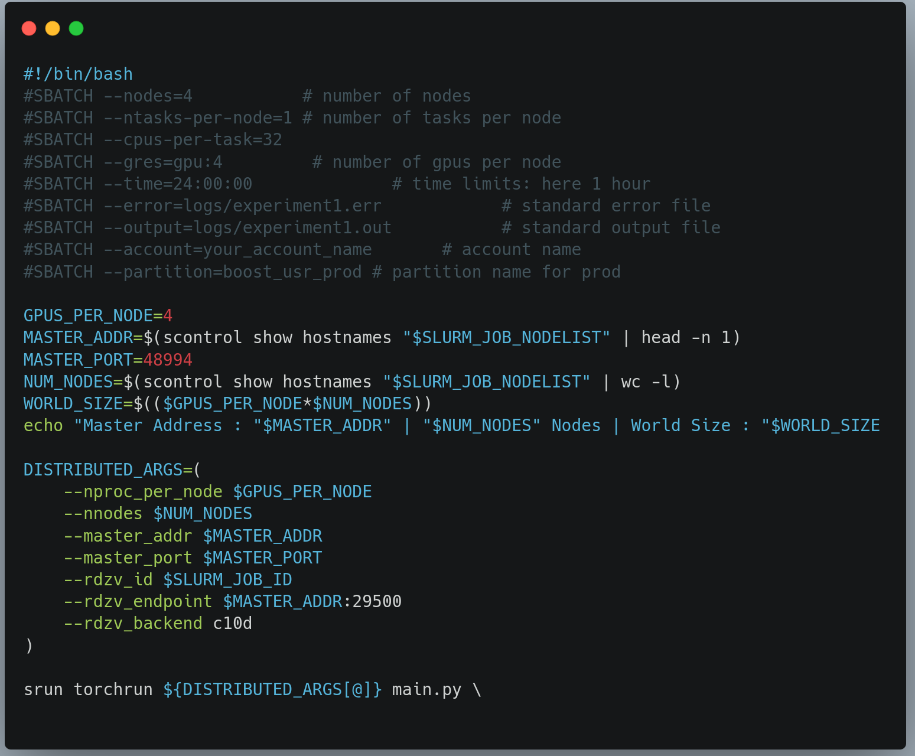

Slide 9

THANK YOU
Email : j-g.barthelemy@linguacustodia.com
Huggingface : https://huggingface.co/LinguaCustodia
Website : https://www.linguacustodia.finance/
Linkedin : https://www.linkedin.com/in/jean-gabriel-barthelemy/
X : https://x.com/JG_Barthelemy

