Slide 1
May 2025
AI Factories Infrastructure

Slide 2
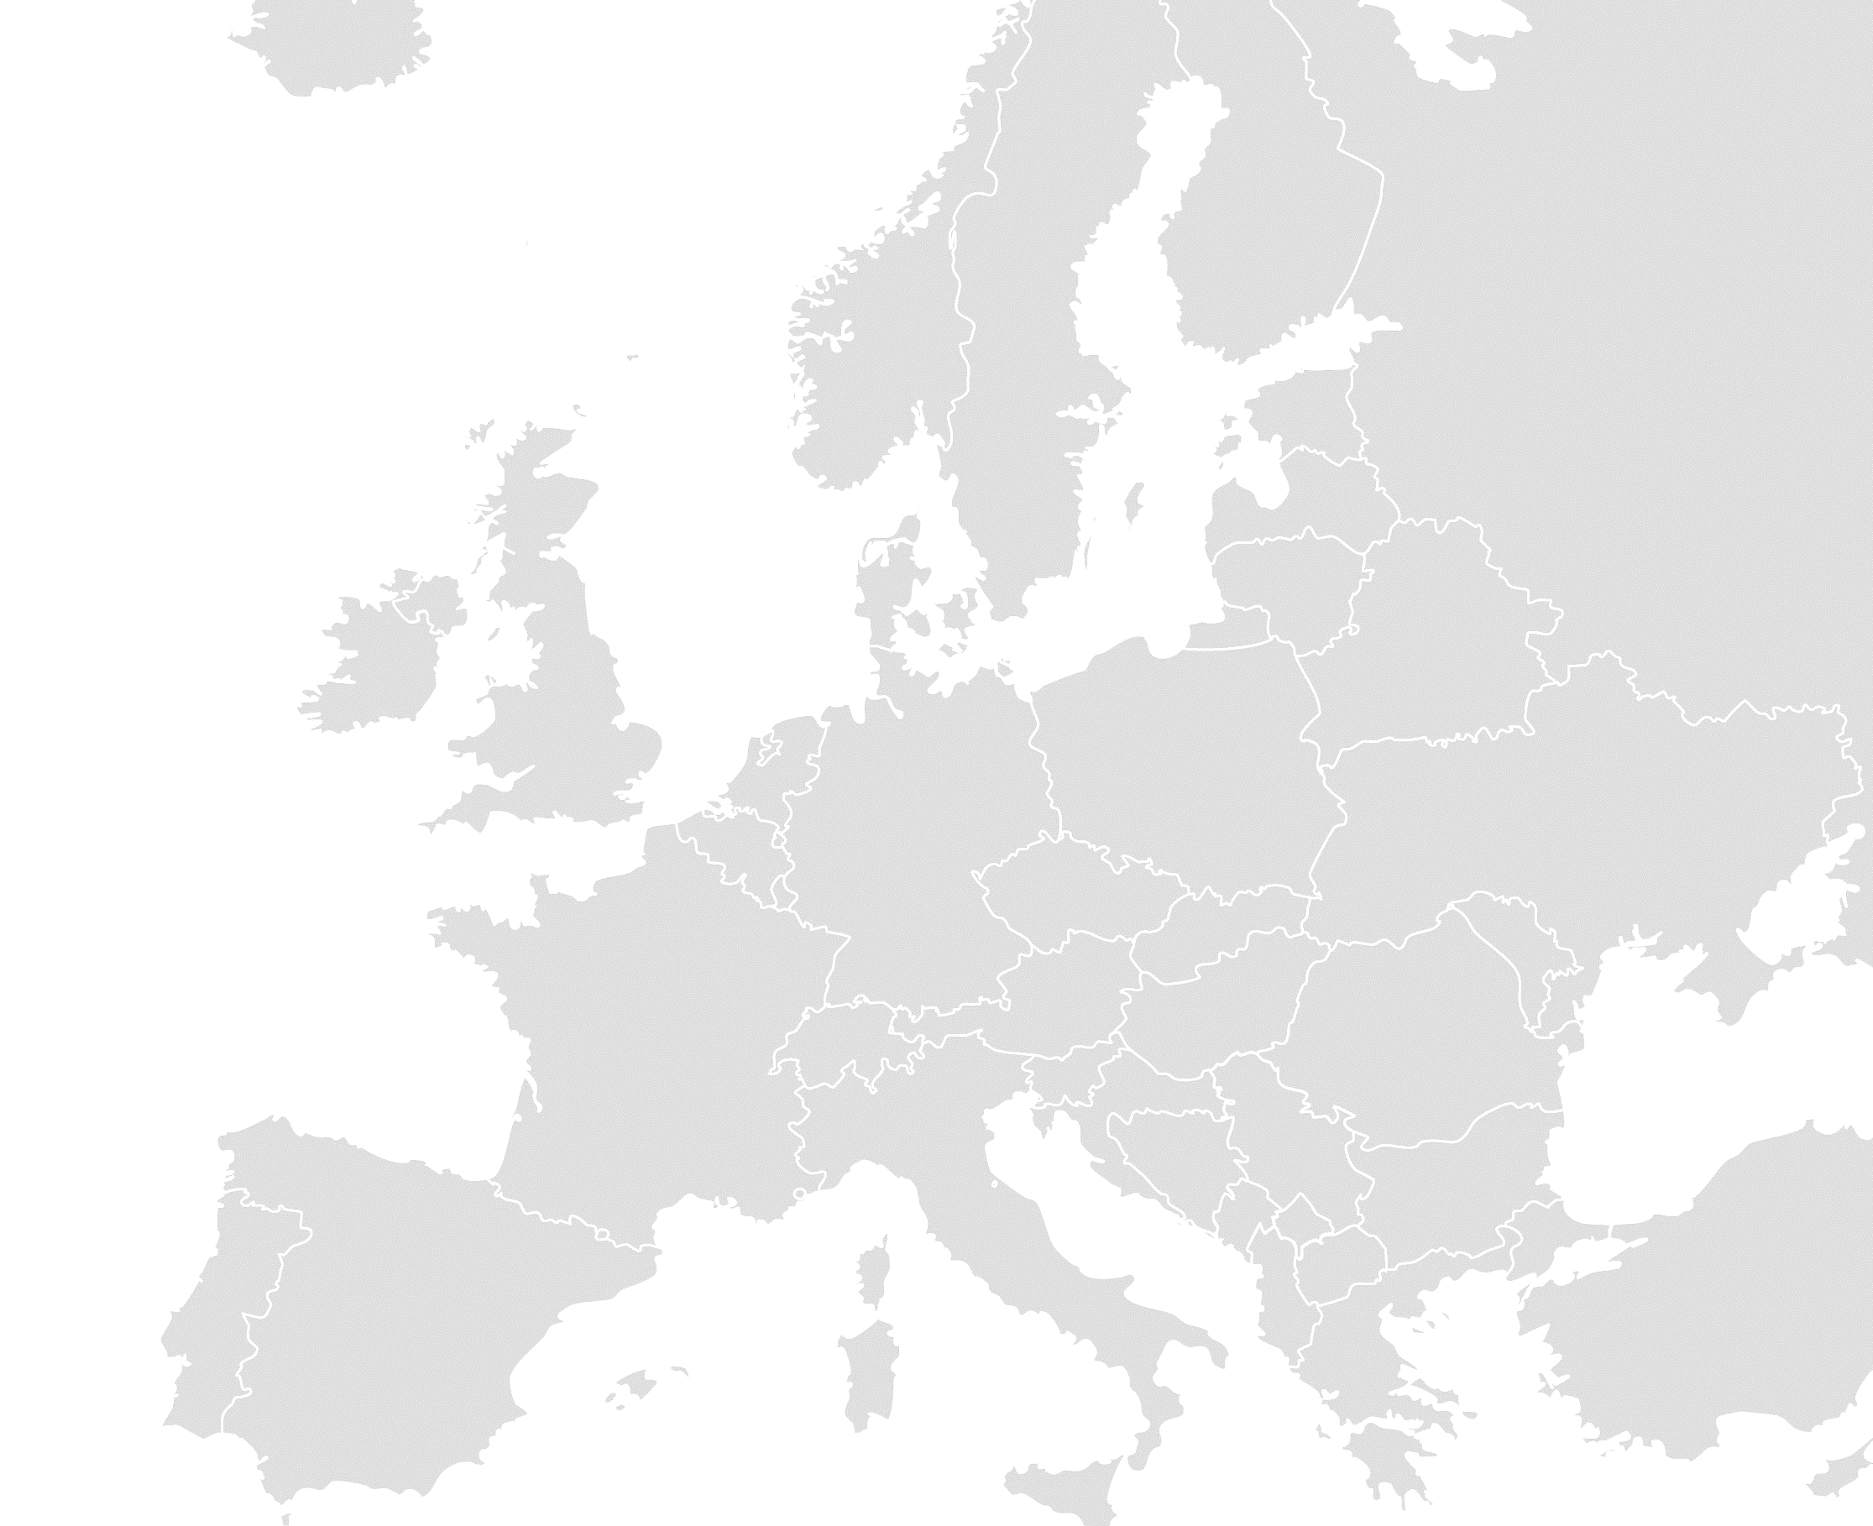
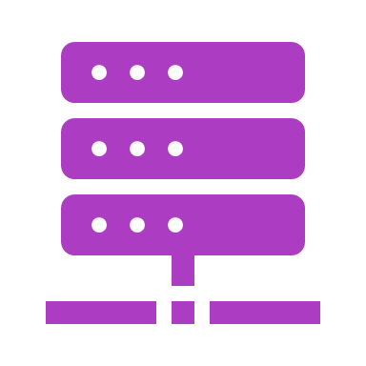
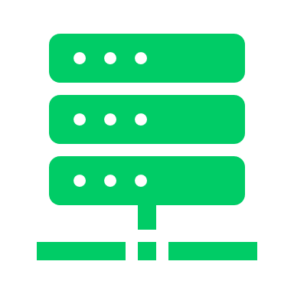

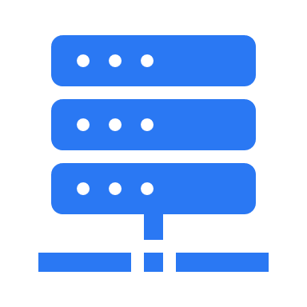
The EuroHPC Supercomputing Ecosystem
Supercomputers already available for access
Operational
Lumi (FI)
Arrhenius (SE)
Coming soon…
EXASCALE
Coming sooner…
Operational
Operational
PRE-EXASCALE
JUPITER (DE)
Karolina (CZ)
MeluXina (LU)
Alice Recoque (FR)
Operational
PETASCALE
In procurement
Vega (SI)
Operational
Recently upgraded
Discoverer (BG)
MID-RANGE
Operational
Leonardo (IT)
Deucalion (PT)
Operational
LISA upgrade awarded
MareNostrum 5 (ES)
Coming soon…
Operational
Daedalus (GR)

Slide 3
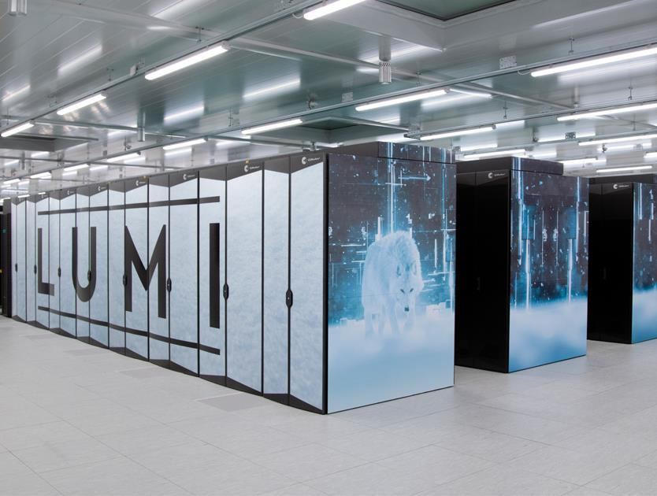
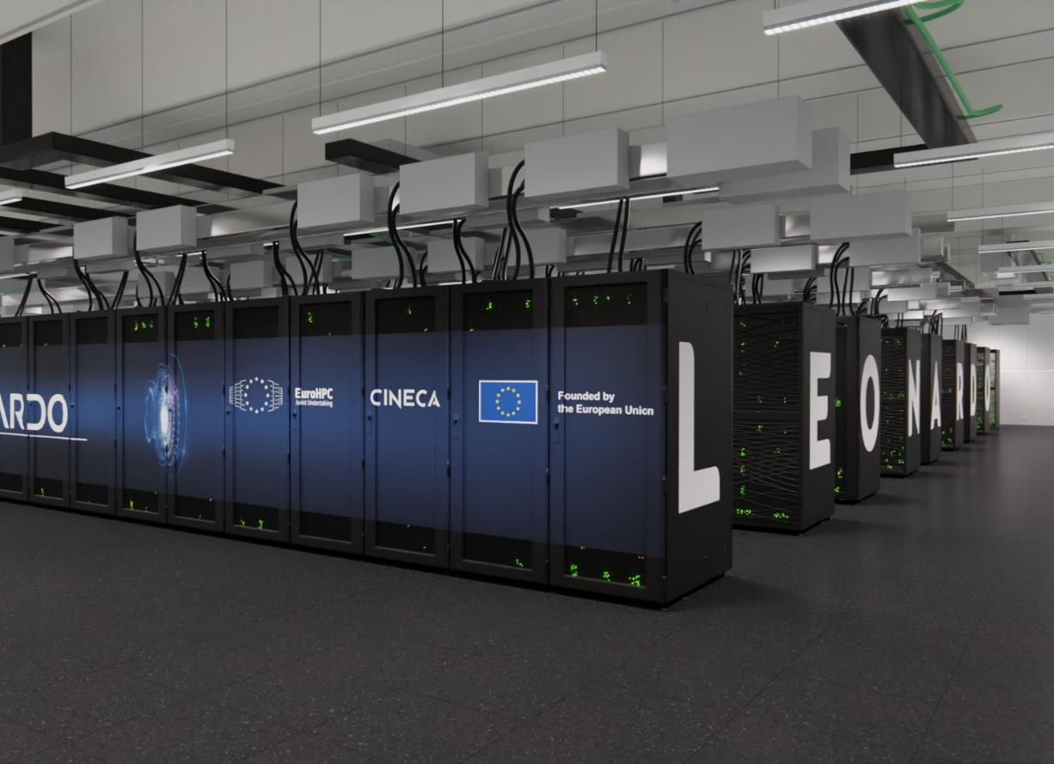
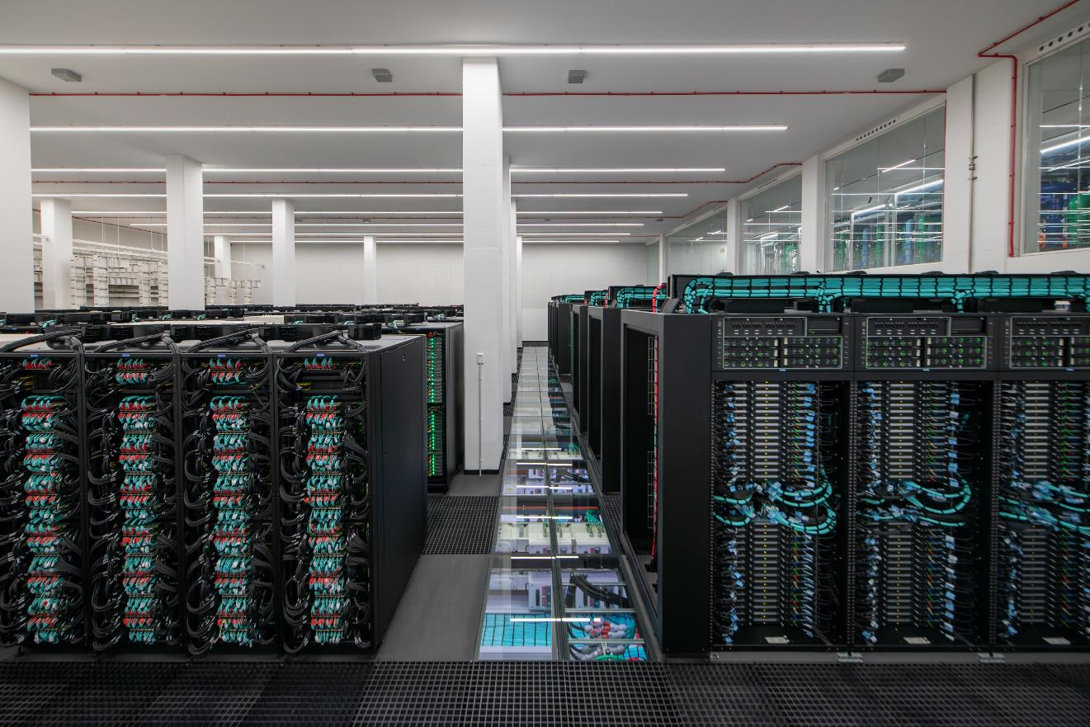
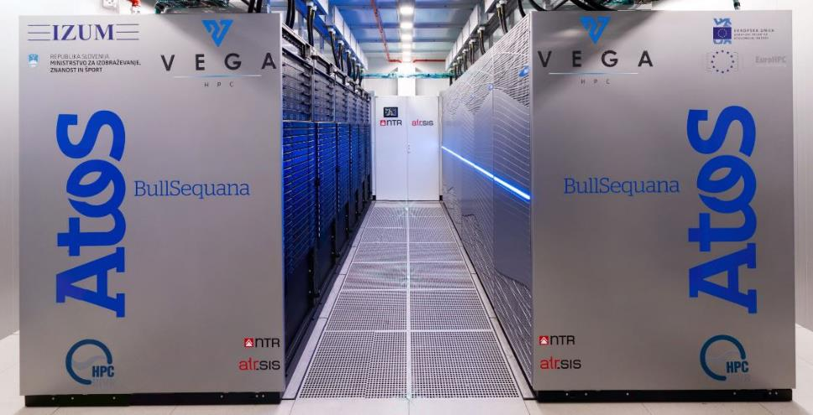
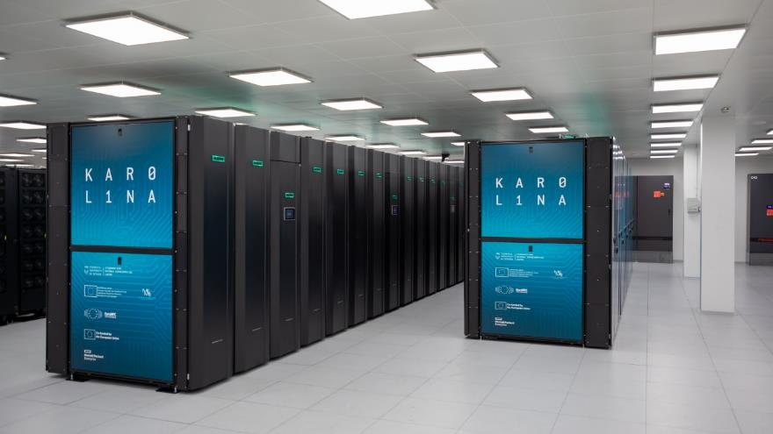
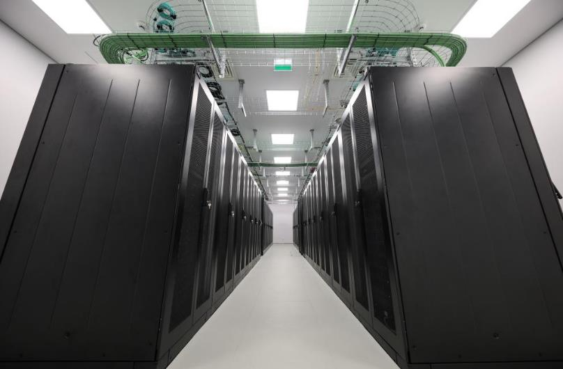
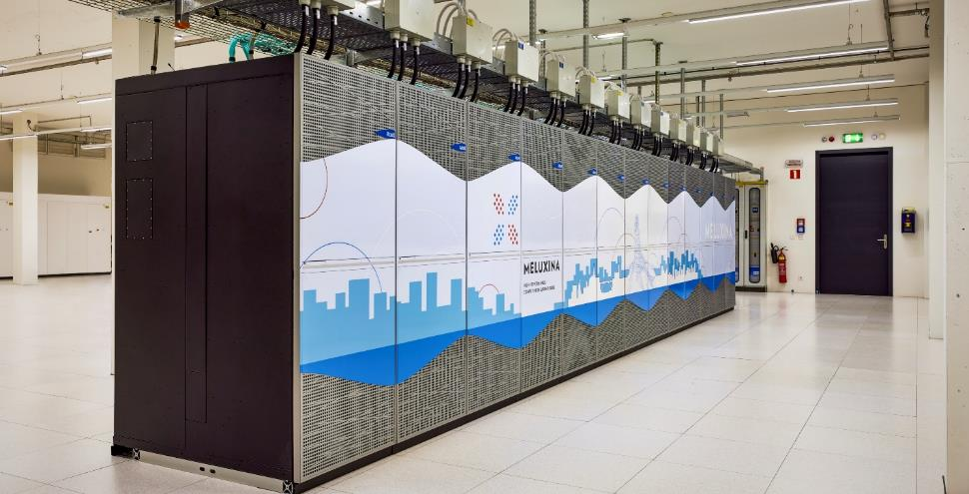
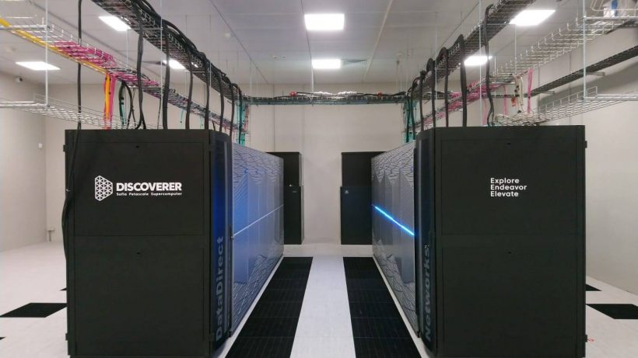
Available EuroHPC supercomputers
EuroHPC systems in numbers
893 PFlops
Aggregated sustained Linpack performance
20 partitions
15597 CPU Nodes (AMD/Intel x86 and Fujitsu ARM)
7869 GPU Nodes
43476 GPUs (NVidia A100/H100, AMD MI250X)
Other: FPGA, Visualisation and Cloud capabilities
LUMI (CSC)
Kayaani, Finland
Leonardo (CINECA)
Bologna, Italy
MareNostrum 5 (BSC)
Barcelona, Spain
Cray EX, Hewlett Packard Enterprise
#5 Top500 (May 2024): 379.7 PFlops (LUMI-G)
Atos BullSequana XH2000
#7 Top500 (May 2024): 241.2 PFlops (BOOSTER)
Atos BullSequana XH3000 / Lenovo ThinkSystems
#8 Top500 (May 2024): 175.3 PFlops (GPU Partition)
#22 Top500 (May 2024): 40.1 PFlops (CPU Partition)
Vega
Karolina
Deucalion
Fujitsu FX700 (Arm) / Atos (x86)
MeluXina
Discoverer
Atos BullSequana XH2000
HPE Apollo
Atos BullSequana XH2000
Atos BullSequana XH2000

Slide 4
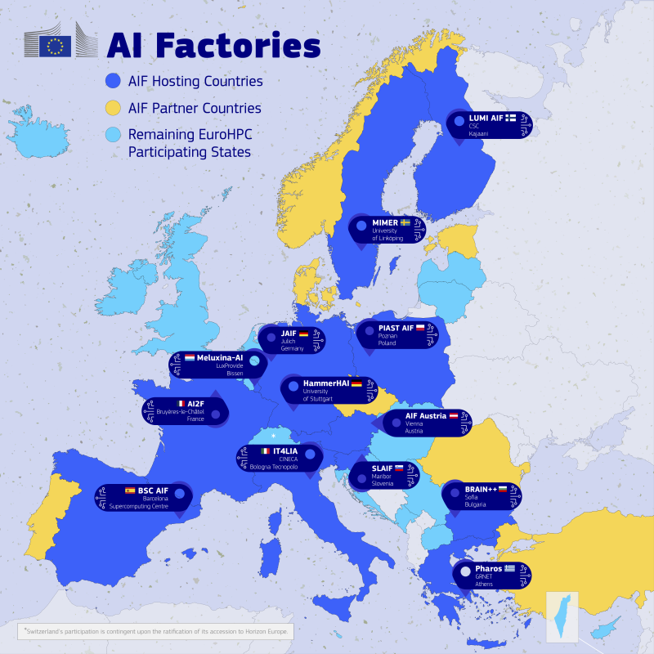
The EuroHPC AI Factories
LUMI (LUMI AI coming)
AIFs using existing systems
JAIF (JUPITER)
AI2F (Alice Recoque)
Pharos (Daedalus)
AIFs temporarily offering existing systems
BSC (MN5… waiting for MN5 upgrade)
IT4LIA (Leonardo/LISA… waiting for Leonardo-AI)
LUMI AIF (LUMI.. waiting for LUMI-AI)
LuxProvide (MeluXina… waiting for MeluXina-AI)
BRAIN++ (Discoverer+… waiting for Discoverer++)
SLAIF (Vega… waiting for Vega-AI)
AIFs with upcoming new systems
HammerHAI | HLRS, Stuttgart
PIAST AIF | PSNC, Poznan
AI:AT Austria | ACA, Vienna
MIMER | LU, Linkoping
New system loading…
JUPITER
New system loading…
New system loading …
MeluXina (MeluXina-AI coming)
Alice Recoque
New system loading…
Discoverer+ (Discoverer++ loading…)
Leonardo (Leonardo AI loading…)
Daedalus
MN5
(AI Upgrade loading…)
Vega
(Vega AI loading…)
https://eurohpc-ju.europa.eu/ai-factories/ai-factories-systems_en

Slide 5
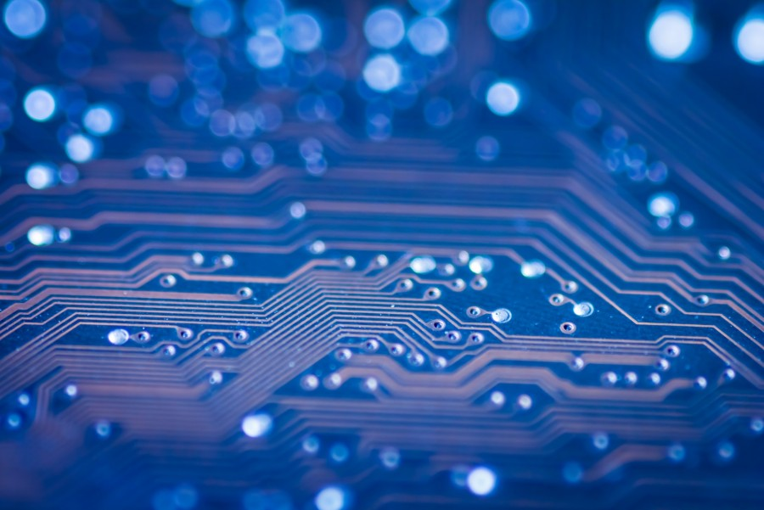





Thank you!
Keep up with EuroHPC news:
https://eurohpc-ju.europa.eu
@EuroHPC_JU
EuroHPC Joint Undertaking

