Slide 1

AI Factories : Open for Business
Welcome
Webinar
20 May 2025

Slide 2
AI Factories : Open for Business
EuroHPC gateway to AI Factories

Slide 3
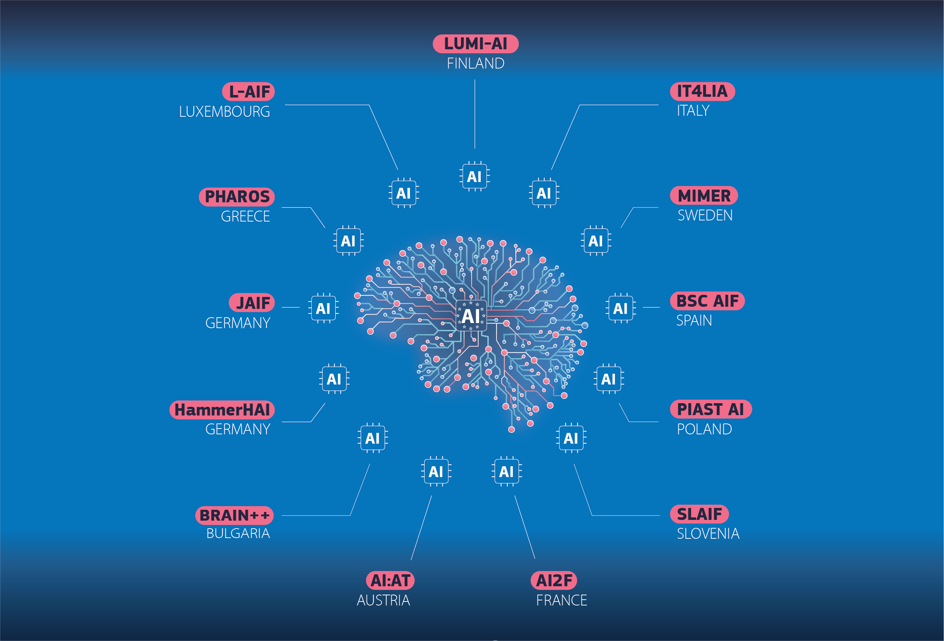
Our AI Factories

Slide 4

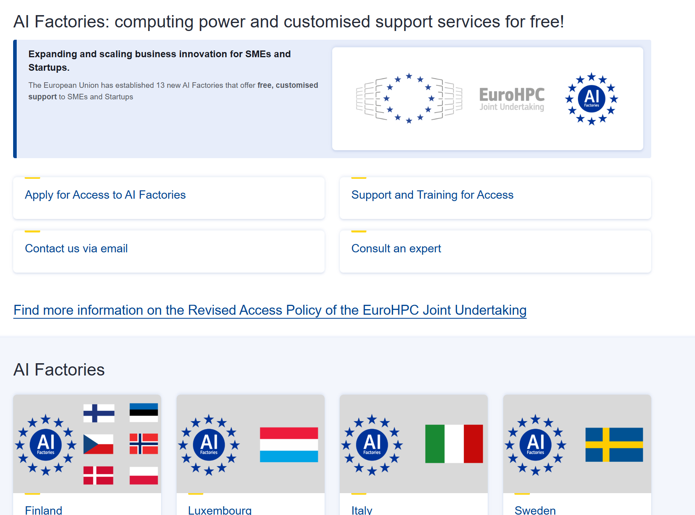
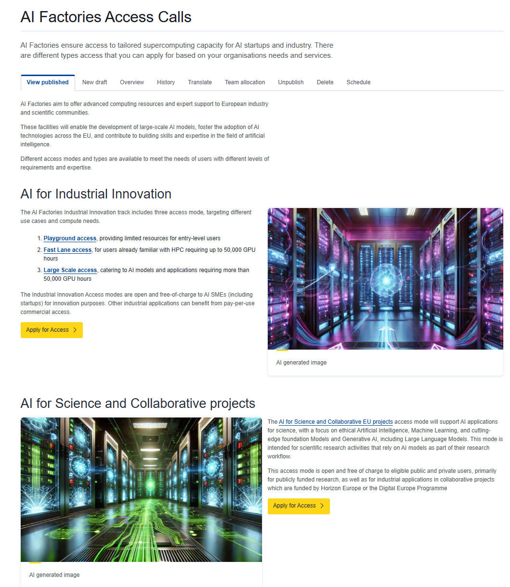
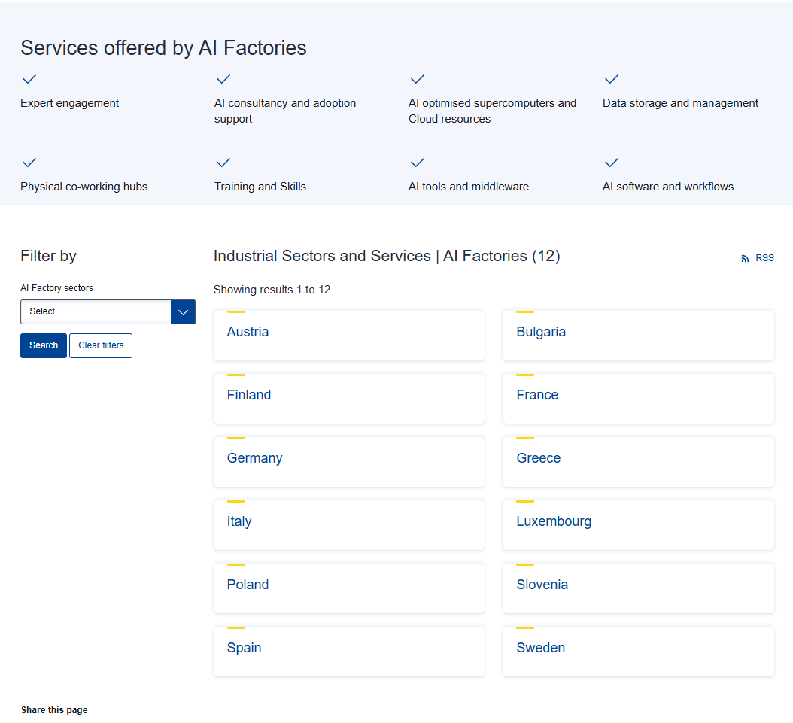
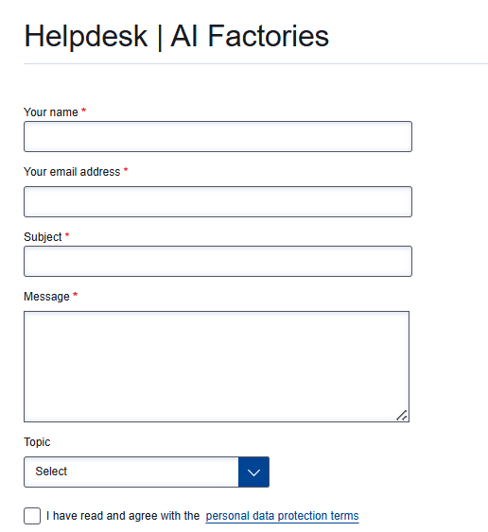

Slide 5
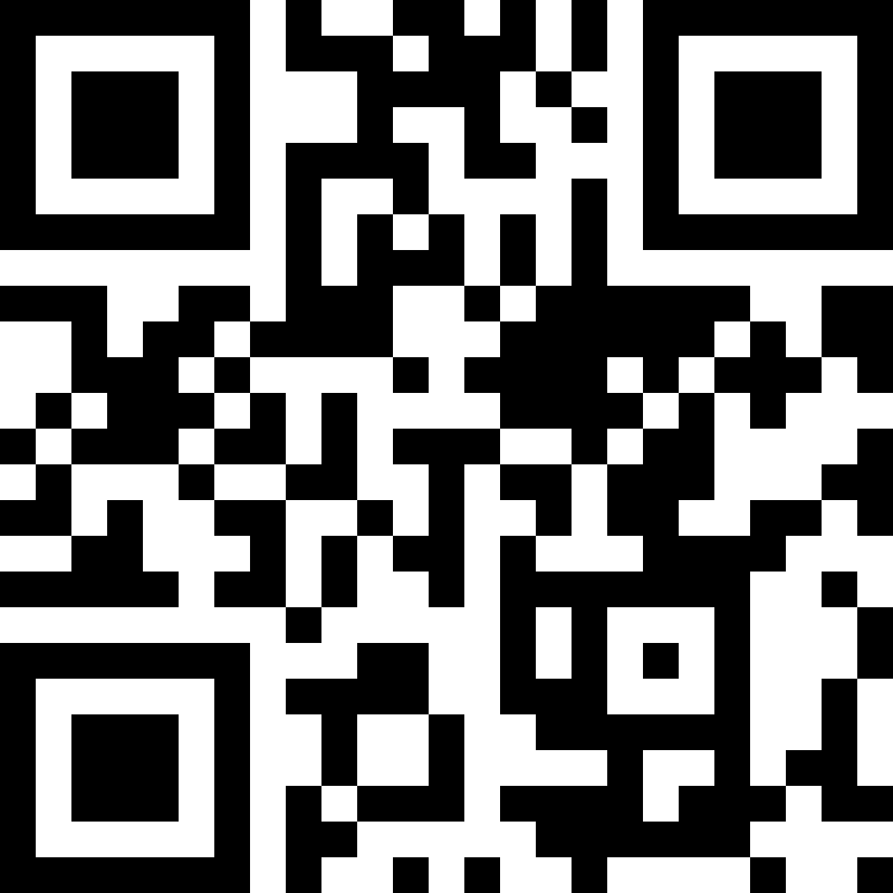




THANK YOU
For questions and queries contact: aif.access@eurohpc-ju.europa.eu
QR code :
Follow us on
https://www.youtube.com/@eurohpc-ju
www.linkedin.com/company/eurohpc-ju
@EuroHPC_JU
eurohpc-ju.bsky.social
See you in Copenhagen for the User Days from Sept 30 – Oct 1

