Slide 1







THE EUROPEAN HIGH PERFORMANCE COMPUTING ​
JOINT UNDERTAKING
AI Factories : Open for Business
Germany’s First AI Factory for Industry
and Academia
Webinar
20 May 2025

Slide 2
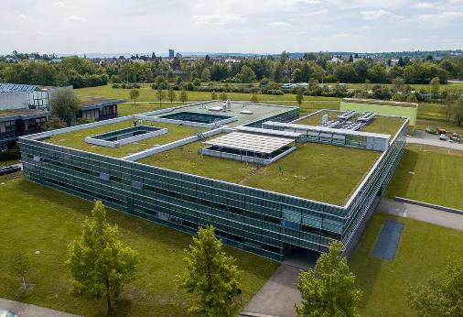
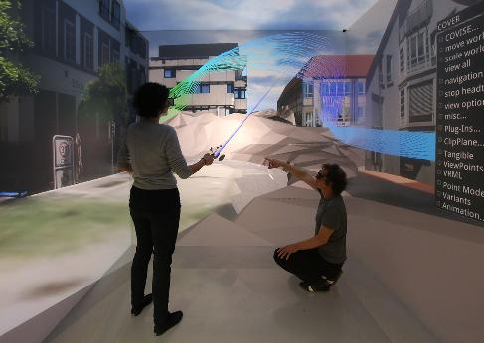
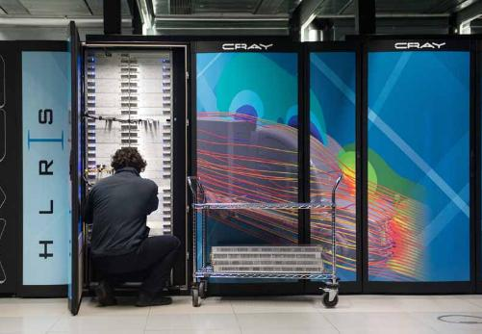


Germany’s First AI Factory for Industry and Academia
Focuses on start-ups, SMEs, industry, academia, and the public sector
Experience
  Services more than 70 industrial customers
    Porsche, Trumpf, Festo, ...
  ISO 27001 and TISAX Level 3 certifications
  Well established user accounting and user helpdesk (HPC/AI)
  Mature ecosystem to handle business requests
  Leadership in European projects with focus on industry such as EXCELLERAT P2 and FFPlus

Slide 3
Expected AI User Requirements
Primary tasks
  Fine-tuning of pre-trained models with moderate resource requirements at first, continuously increasing over the following years
  Querying an AI model in production (inference in production)
Requesting a secure environment for training and inference
Asking for ease of migration of existing (Cloud) workloads to HammerHAI
  Run containerised applications
  Request easy access to data and compute resources
We foresee extended user support, especially for the onboarding of companies
  Software ecosystem and job submission similar to the Cloud is essential
  User documentation will be crucial

Slide 4
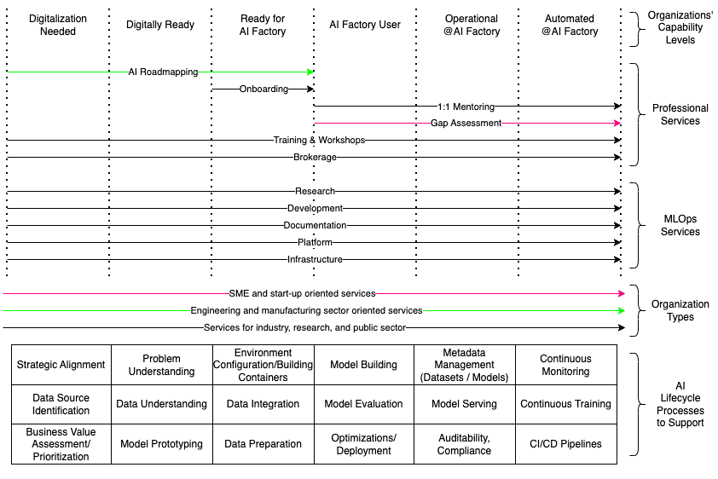
User Support Services
Each user gets assigned a dedicated person (“concierge”) that accompanies them from onboarding to production.

Slide 5
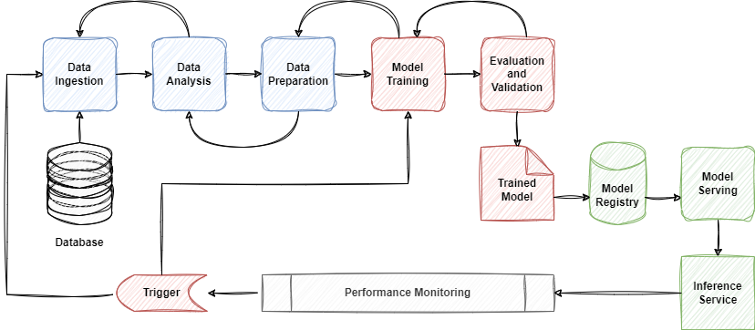
HammerHAI Goal: Support the entire AI Lifecycle

Slide 6
HammerHAI Infrastructure
Now: Leverage existing AI-specific infrastructures at
  HLRS, LRZ, GWDG, and KIT
  Cooperation with other EuroHPC JU Hosting Entities being an AI Factory
Near Future: The HammerHAI System
  Procurement of the dedicated system was started in April 2025
  Contract signature expected by October/November 2025
  First partition of the AI-optimised supercomputer to be delivered in Q1/26
  Goal: Operational as soon as possible

Slide 7


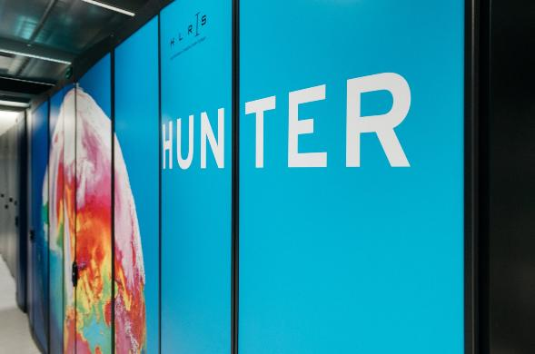
First Steps (preparation phase)
Main principle of HammerHAI: No re-invention of the wheel, make things as quick as possible available. Users drive the evolution!
KafkaLM (https://kafkalm.com/kafka-3.1)
Seedbox.ai trained multi-lingual LLMs on Hunter
  KafkaLM-8B and KafkaLM-70B
  24 languages supported
Workload is about 30 hours on 32x AMD MI300A
Pre-HammerHAI Action to validate service provisioning to Startups

Slide 8
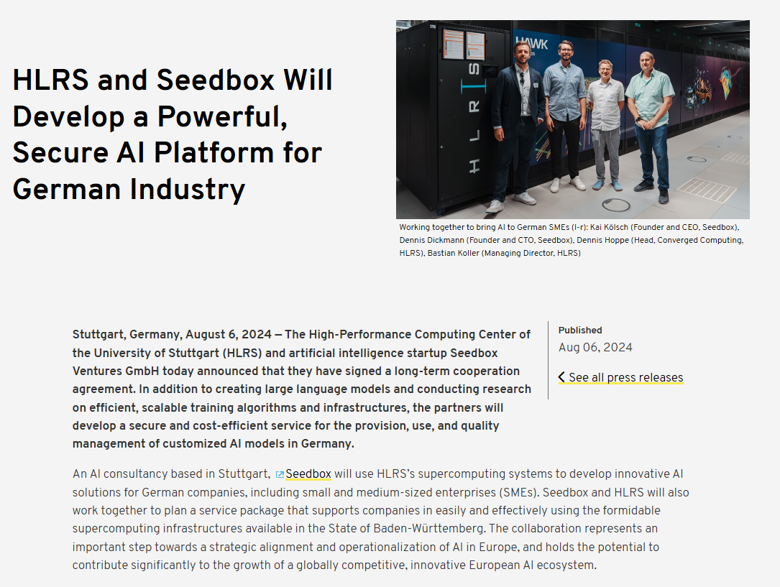
Goal: GenAI Platform for HammerHAI
Secure AI Platform for SMEs
  Hosting of AI models for inference
  Cost-efficient and secure access to supercomputing resources
  Local hosting for secure handling of proprietary and sensitive data
  Partnership with Seedbox.ai

Slide 9
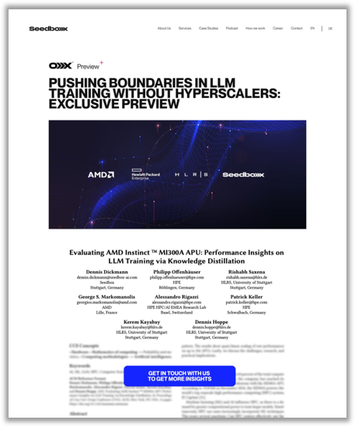
Goal: First success stories as quick as possible
Services in creation (collaboration with Seedbox.AI):
  Inference API:
    A simple API to talk to SOTA open source models
    Painless access
    OpenAI-compatible API​
    Seedbox Automodel: a custom-trained classifier will figure out the best model to use regarding cost-to-quality.​
    Available Models (for now): Llama 3.1 Family, Phi 2 Family, Qwen 2 Family
    Service to be released soon as showcase for HammerHAI users
    Commercial access will be possible
  Demo planned at ISC 2025

Slide 10

Conclusion
Even though the main infrastrucure is currently procured, service operation started 1st of April, 2025
Onboarding of collaborators is ongoing
No re-invention of the wheel, use of synergies
The ecosystem is ready to work with industry and academia on a most professional level
First services from users for users to be deployed soon
Success stories will be continuously published
Ready to help you to tackle your challenges

Slide 11
Thank you!
Visit us at
Website: www.hammerhai.eu
LinkedIn: https://www.linkedin.com/company/hammerhai
Bluesky: https://bsky.app/profile/hammerhai-eu.bsky.social
Bastian Koller
Managing Director HLRS/Coordinator of HammerHAI
High Performance Computing Center (HLRS)
University of Stuttgart
Nobelstr. 19
D-70569 Stuttgart, Germany
phone: +49-711-685-65891
fax: +49-711-685-65832
mail: koller@hlrs.de
web: www.hlrs.de

