Slide 1
Quantum Computing
Introduction
ANNOTATION

Slide 2
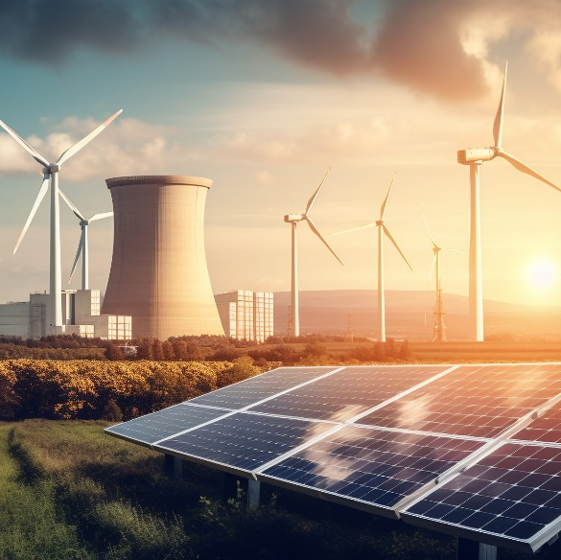

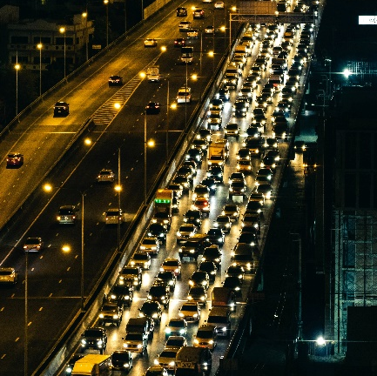

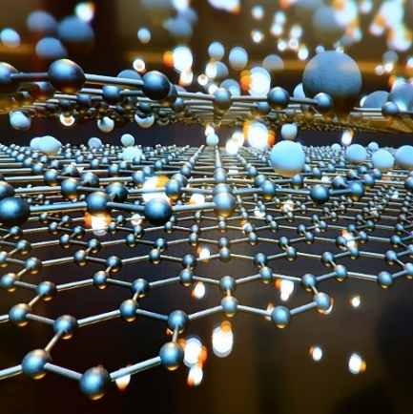

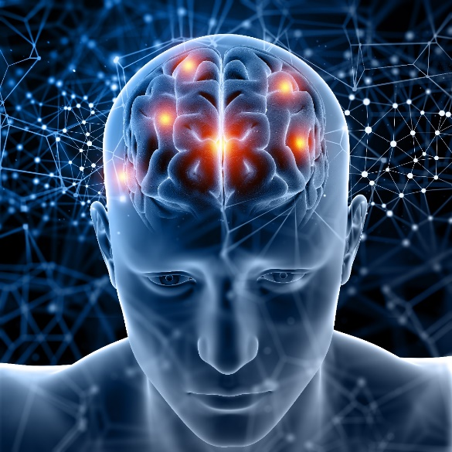
Quantum Computing
… promises to solve some of our toughest problems
Energy grid management
Supply chain logistics
Traffic optimization
Vegetation evolution −
climate change
Human brain functionality –
neural networks
Drug design
Materials design

Slide 3
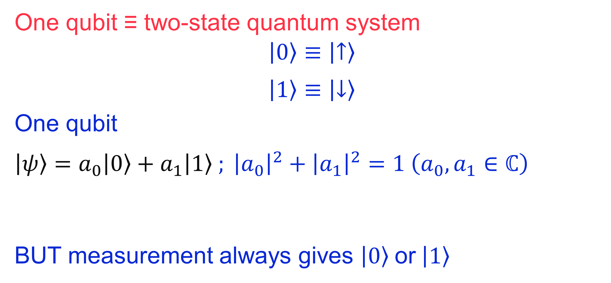
Quantum computer: one qubit
One qubit ≡ two-state quantum system
$$\left.\left|0\right.\right\rangle ≡\left.\left|↑\right.\right\rangle$$
$$\left.\left|1\right.\right\rangle ≡\left.\left|↓\right.\right\rangle$$
One qubit
$\left.\left|ψ\right.\right\rangle =a_{0}\left.\left|0\right.\right\rangle +a_{1}\left.\left|1\right.\right\rangle ; {\left|a_{0}\right|}^{2}+{\left|a_{1}\right|}^{2}=1 \left(a_{0},a_{1}∈ℂ\right)$
BUT measurement always gives $\left.\left|0\right.\right\rangle$ or $\left.\left|1\right.\right\rangle$
Two basis states
SUPERPOSITION

Slide 4
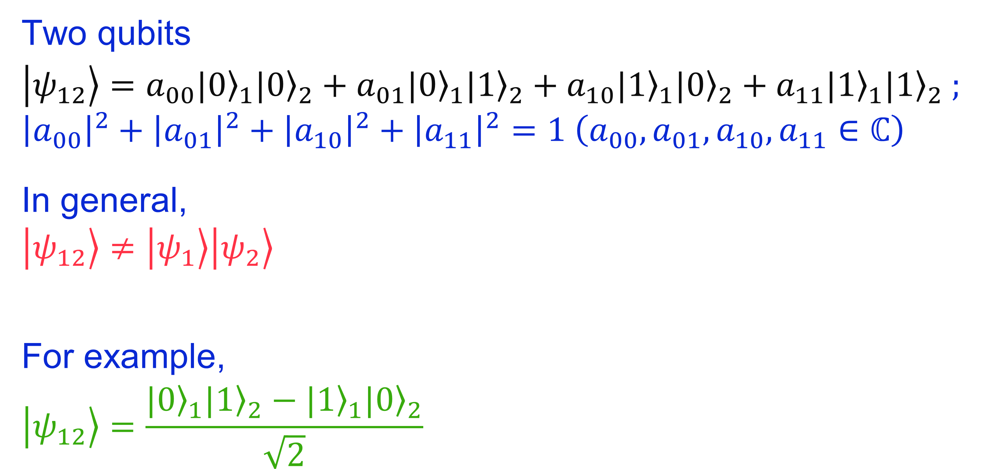
Quantum computer: two qubits
Two qubits
$$\left.\left|ψ_{12}\right.\right\rangle =a_{00}{\left.|0\right\rangle }_{1}{\left.|0\right\rangle }_{2}+a_{01}{\left.|0\right\rangle }_{1}{\left.|1\right\rangle }_{2}+a_{10}{\left.|1\right\rangle }_{1}{\left.|0\right\rangle }_{2}+a_{11}{\left.|1\right\rangle }_{1}{\left.|1\right\rangle }_{2} ; \\ {\left|a_{00}\right|}^{2}+{{\left|a_{01}\right|}^{2}+{\left|a_{10}\right|}^{2}+\left|a_{11}\right|}^{2}=1 \left(a_{00},a_{01},a_{10},a_{11}∈ℂ\right)$$
In general,
$$\left.\left|ψ_{12}\right.\right\rangle ≠\left.\left|ψ_{1}\right.\right\rangle \left.\left|ψ_{2}\right.\right\rangle$$
For example,
$$\left.\left|ψ_{12}\right.\right\rangle =\frac{{\left.|0\right\rangle }_{1}{\left.|1\right\rangle }_{2}−{\left.|1\right\rangle }_{1}{\left.|0\right\rangle }_{2}}{\sqrt{2}}$$
SUPERPOSITION
ENTANGLEMENT
SINGLET STATE

Slide 5

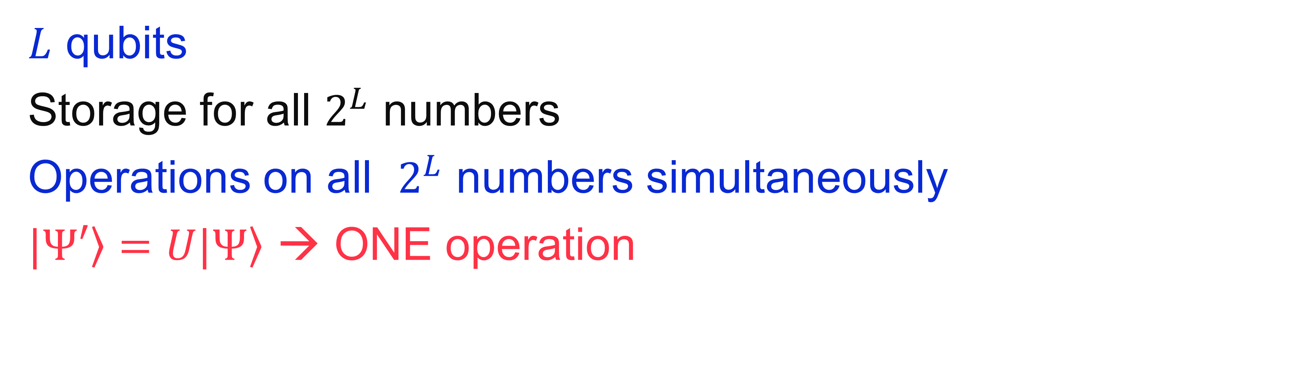

Quantum computer: $L$ qubits
$L$ qubits
Storage for all $2^{L}$ numbers
Operations on all $2^{L}$ numbers simultaneously
$\left.|Ψ′\right\rangle =U\left.|Ψ\right\rangle$ → ONE operation
SUPERPOSITION
MASSIVE PARALLELISM
Quantum mechanics may allow computers to calculate faster

Slide 6
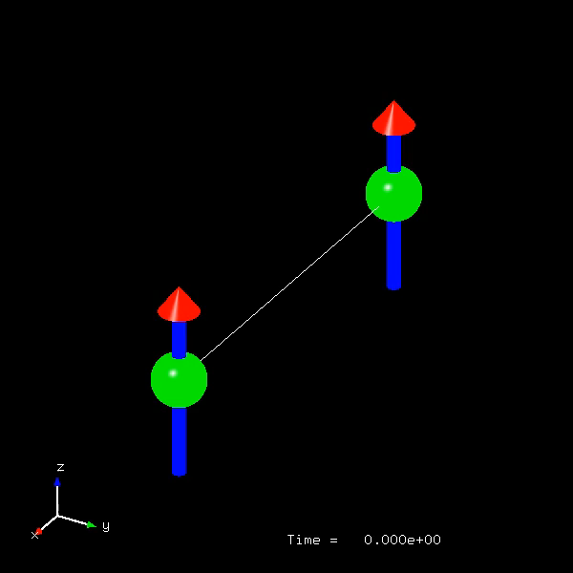
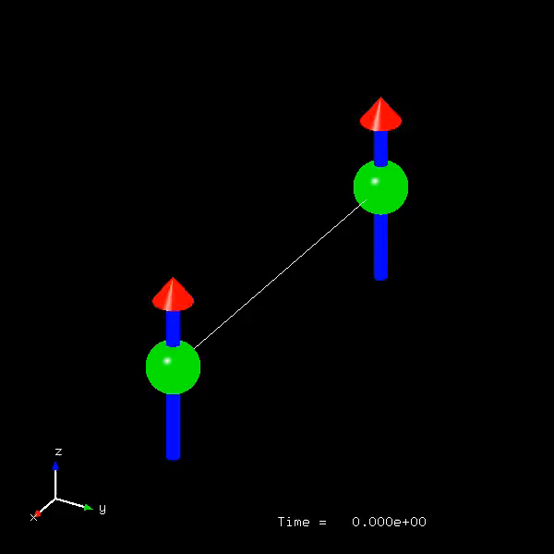

Why is quantum computing so difficult in praxis?
ALGORITHM
THEORETICAL QC
PRACTICAL QC
Initialize ${\left.|0\right\rangle }_{1}{\left.|0\right\rangle }_{2}$
Create $\frac{{\left.|0\right\rangle }_{1}{\left.|1\right\rangle }_{2}−{\left.|1\right\rangle }_{1}{\left.|0\right\rangle }_{2}}{\sqrt{2}}$
Apply 5X CNOT
Read out

Slide 7
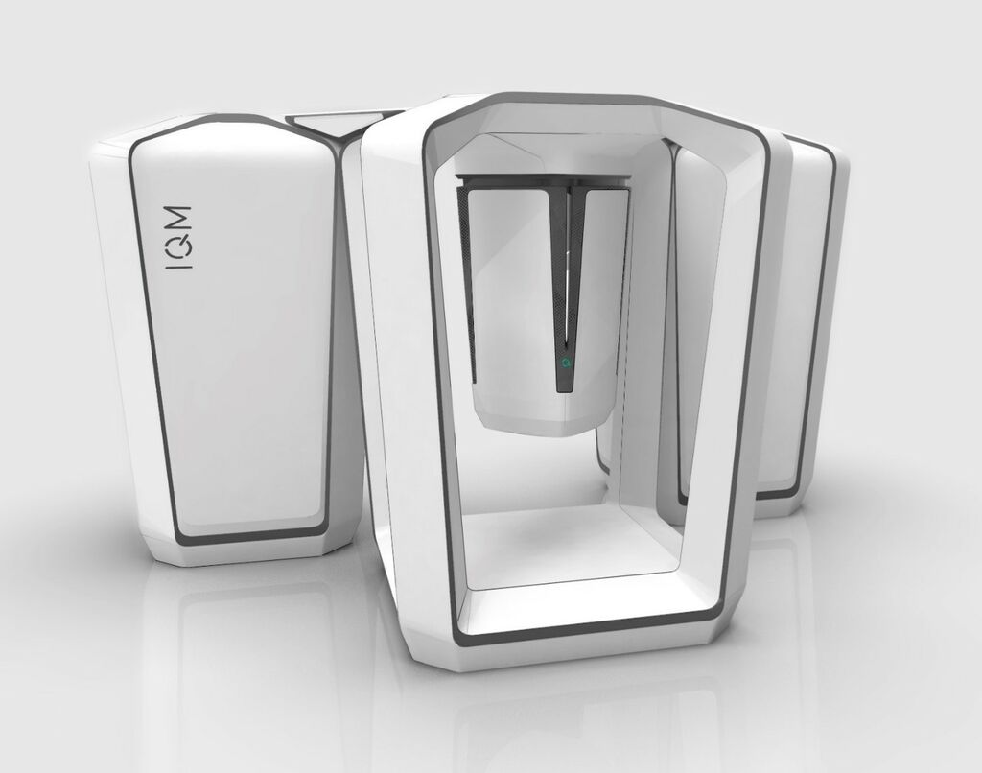
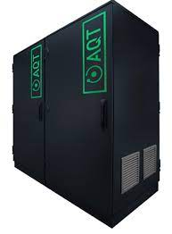

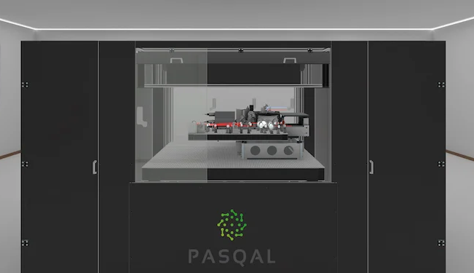
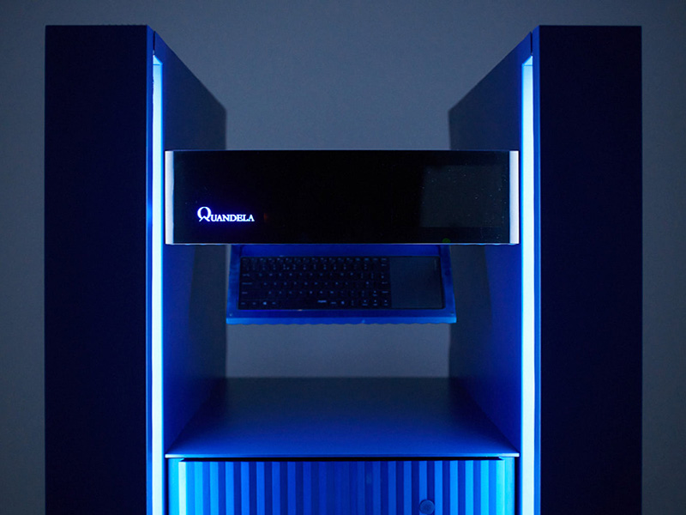
Physical realizations of quantum computers
Superconducting qubits
Trapped-ion qubits
Neutral atom qubits
Photonic qubits

